Slide 1
Daily reading
Have a book with you at all times
10-15 minutes in class
150-250 page book in class
15-20 pages a day
A response (on form)
Stretch w/VARIETY: genre, time, place, character’s culture, religion, ability, gender, economic status
Does the story seem interesting?
Will it stretch me into a new place, time, culture, experience, genre?
Is the font and feel of the book comfortable?
Can I finish it in a week or two (because the goal of the quarter is to read a VARIETY)?

Slide 2
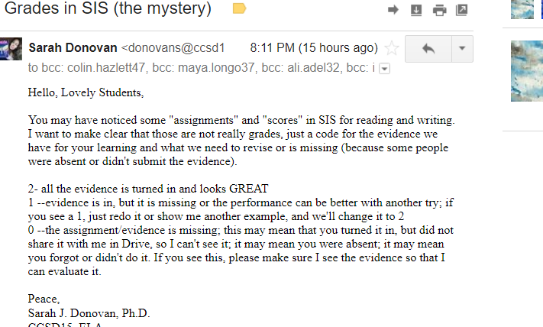

Slide 3
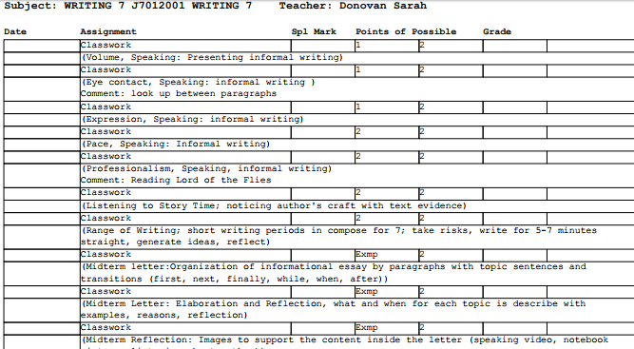

Slide 4
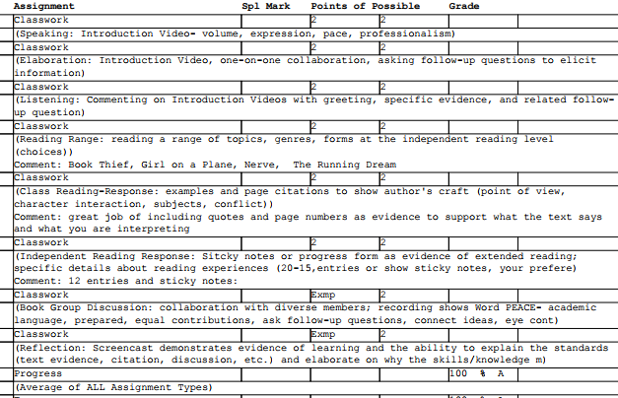

Slide 5



Read for 15
Book open
3 sticky notes
Go for 15-20 pages
No walk, no talk
8/24 page______
An older or wiser character is...
8/24 pages ____
A place or things that might be a symbol is....
8/24 pages _____
A part I liked/got annoyed with is....

Slide 6

Reading Response
8/17
Always add “for example” and “because”
include a page number for text evidence
The genre of the book is _________; for example, ____________________. This matters/does not matter in the first pages of the book because ....

Slide 7
Reading Response
8/17
Always add “for example” and “because”
include a page number for text evidence
Insolent means “showing a rude and arrogant lack of respect” (dictionary.com). The main character’s name is...., and (name) is/is not insolent ; for example, in one scene, what happens is....and (name) reacts by...(page).This proves (name) is/is not insolent because.... I am/am not insolent because...

Slide 8
Reading Response
8/25
Always add “for example” and “because”
include a page number for text evidence
Talk - no tech -- Would you be friends with the characters in the book? Why or why not? Give specific reasons.
Similar to what _____said, I think.....
I like what ______ said, which was .....in my book....

Slide 9
1st Quarter Reading Goal: read a variety of books
 | Monday | Tuesday | Wed. | Thurs. | Friday | Sat. | Sun. | total
1 | 20 home 10 school | 20h 10s | 20h 10s | 20h 10s | 20h 10s | 20h 10s | 20h 10s | 140 pages at home +70 at school=210 page
2 |  |  |  |  |  |  |  | Book 1 done
3
4 |  |  |  |  |  |  |  | Book 2 done
5
6 |  |  |  |  |  |  |  | Book 3 done
7
8 |  |  |  |  |  |  |  | Book 4 done
9

Slide 10








Form Genre Character Place Time | Graphic memoir, Chicago; verse realistic fiction, LA/Ghana; science fiction, electricity, boy’s mom missing; realistic fiction,amputee athlete; transgender fiction; verse historical Vietnam; verse historical WWII Japanese internment camps; historical fiction, WWII set in Korea Books under 300 pages

Slide 11
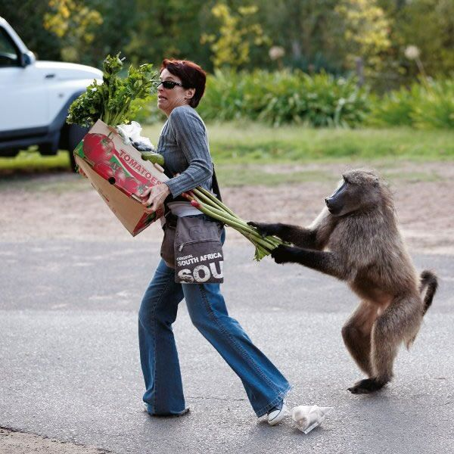
Police officers should not have guns.
A police officer is defined as...
On one hand, some say yes because... ; for example, ...
On the other hand, some say no because...; for example, ...
Here is what I say...
Describe your bedroom now or your dream bedroom
Colors, smells, furniture, lighting, flooring, items (stuffed animals, picture frames, posters, pillows), how it makes you feel, what you do

Slide 12
HOBBIES- good at, bad at, want to try
DEATHS
DIVORCE
MARRIAGE
BABIES
FEARS/
WORRIES
PLACES -you love, want to be, good/bad memories
PETS you have, had, want to have
INJURIES/
ACCIDENTS
FOODS- love,hate, want to try
Personal writing ideas
MOVIES
BOOKS
TV
NETFLIX
GAMES
BELOVED OBJECTS
PET PEEVES, what annoys you
PRODUCTS/BRANDS you love.hate
REGRETS/
DISAPPOINT-
MENTS

Slide 13
Share
Number off 1-7
Get into groups with your number with your notebook.
Number off again (1-4 or 5)
#1 says “My name is __________.Today, I wrote about _____. Here it is_______.”
#2-4/5 should say, My name is ______and say...
    I could connect to that because….
    The technique that stood out to me was (figurative language, example, description, emotion).....
    This reminds me of…
    My favorite part is….
    What I learned about you (or your writing) is...

Slide 14
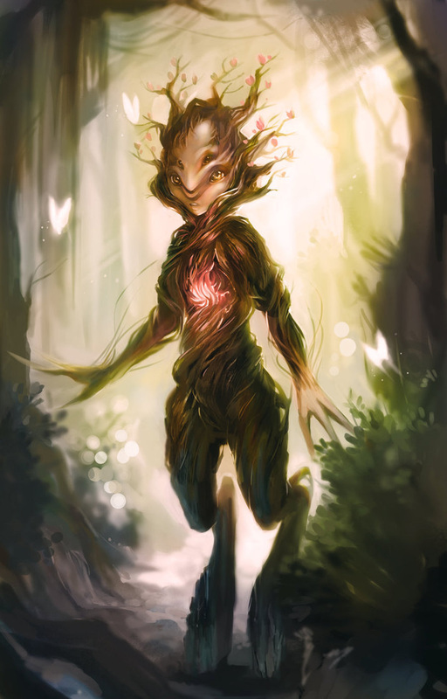
Should schools be closed today because of the eclipse?
An eclipse is...
On one hand, some say yes because...
On the other hand, some say no because...
Here is what I say...
Write about the process of getting ready for school or a sport or any activity with step-by-step detail.
The first step is to
The next step is
Next, I ....
The most challenging is...

Slide 15
Name | Technique to celebrate | Text evidence
 |  | “__________________”

Slide 16
Sharing with VEEP:
Volume, Eye Contact, Expression, Pace, Pronunciation, Professionalism
Name | Celebration of writing technique | Evidence/example
Sarah | dialogue Sensory language Engaging lead Interesting sequence/order Figurative language – simile, symbol Strong examples Unexpected event Creative plot Vivid details Powerful closing humorous | “slimy, sticky, blue gum”
Celebrate with evidence!
I would like to celebrate (name) for his/her (technique); for example, he/she said, “______.”

Slide 17
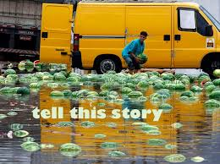
Should people be allowed to comment on Facebook or Twitter (or other social media) anonymously?
On one hand, yes...
On one hand, no...
Now, what I say is...
You are creating a menu to serve to your friends on a special occasion. What will it be? Where will you eat? What is the occasion?

Slide 18
Reading for Flow
What makes “good” writing?
When revising our work, why should we read aloud instead of silently?
  Choose today or yesterday’s piece. Whisper read it to yourself. Change, add, scratch out parts that interrupt the flow of the piece.
  Partner up. A, read aloud; B, say what you liked; switch
  Sharing out: What did you like and why?

Slide 19
every story matters
Welcome,
sit anywhere for now!
2017-18 with Dr. Donovan

Slide 20
Questions
What do we want to know about one another?
On a sticky note, write some questions you’d like to ask one another that have NOTHING to do with school.

Slide 21


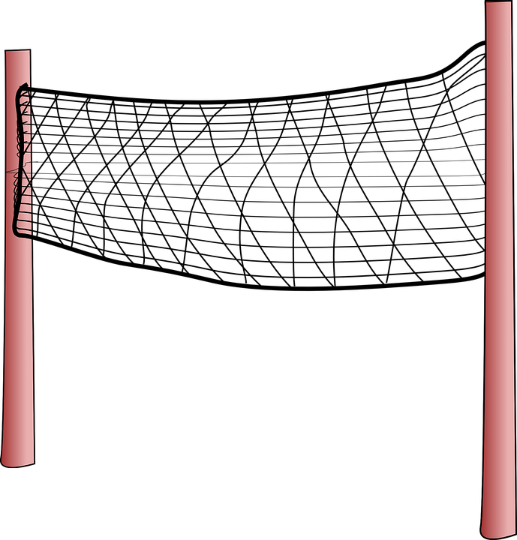
2. Write your name on the folded part (one side with phonetic spelling).
_ _ _ _ _ _ _ _ _ _
(S-AIR-A)
Sarah

Slide 22
3. On side one, do NOT write your name, but do respond to any 4 questions in complete sentences with reasons.
Elementary School: _____________________
My favorite movie is _______because ___
2. I have _____siblings, and the one I am closest to is _____because___________
_______________________________________
3. My dream dinner event would be located ____, and the people there would be _____, and we would eat ______.
4. If money was no concern, I would like to go/buy _______because _______.
One more detail:

Slide 23



4. Find your person! Greet them.
Then, line up.
Person who has your card.
You.
The person whose card you have.
You: Hello, (classmate’s name)!
Classmate: Hello. I guess we are partners.
You: Yes, it’s nice to meet you.
Classmate: Yes, you, too!

Slide 24
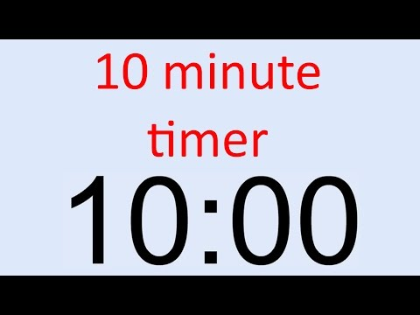
5. Get to know one another.
(ask consent to share 2 bits of information)
Tell me about .....?
Why do you...?
Why don’t you...?
Why is this important...?
What makes this fun/interesting....?
How did you learn/become interested in...?

Slide 25
6. Introduce your classmate with 2 bits of information.
Volume
Eye contact
Expression
Pace
Professionalism
Take a selfie.
Hello, my name is ____________, and I would like to introduce you to _____________.
Notice how to pronounce his/her name,
The most important thing you must know about __________is _____________because_____________
Another thing you should know about ______is
______________. I ask ______(why, how), and what I found out was ________________
Do you have anything in common with _____? Do you have follow-up questions? Ask them in the comment section below.

Slide 26
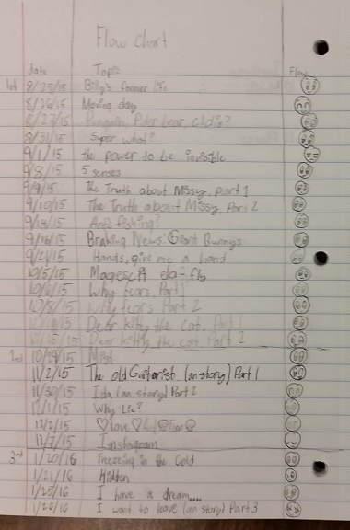
Compose for 7
(start each reading class)
Date it.
Write about anything you want
Change topics if needed.
Draw pictures, charts, cartoons if desired.
Use a prompt or more if needed.
Start an table of contents (FLOW CHART) in the last 5ish pages

Slide 27
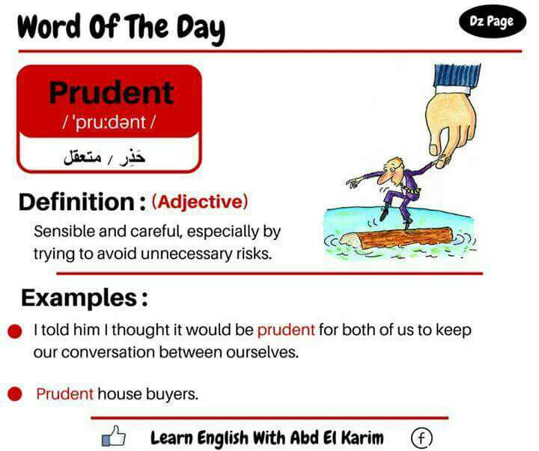

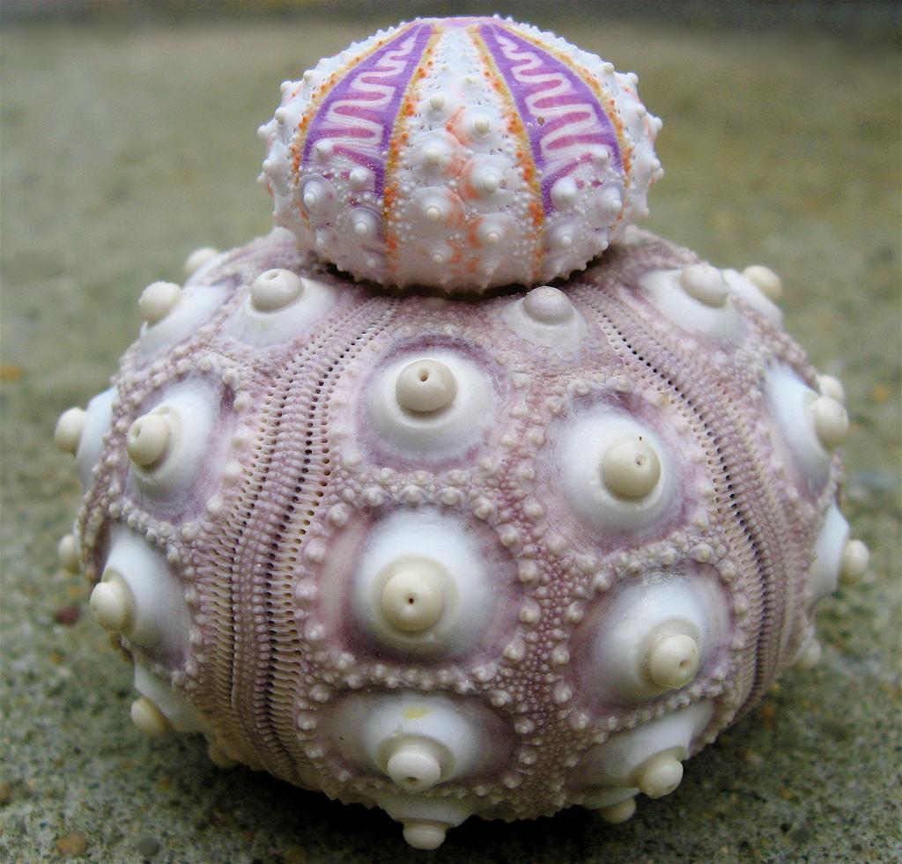
Explain this.
Tell a story about it.
Argue why it is right or wrong
Write from this things’s point of view - it’s life story, it’s first day at school.
Describe this: textures, taste, smell, sounds, color, shape, purpose
Tell a story about a time you were or were not prudent.
Write an argument for why people should and should not be prudent.
Write an explanation of 3 qualities of prudence.

