Slide 1
Welcome to our
NCTE Poetry RoundTable!
EthicalELA teacher writers
Allison Berryhill and Kim Johnson

Slide 2
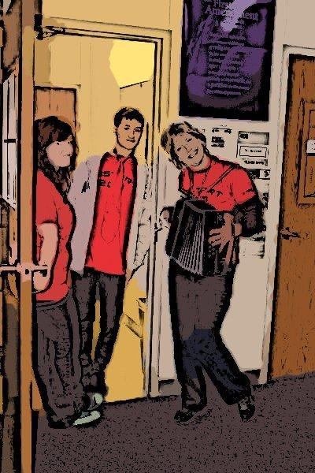
"Suddenly I realize
That if I stepped out of my body I would break
Into blossom. "
— James Wright,
“A Blessing” from
Above the River
Allison
Writing is centering.
It draws my wide and wild
thoughts together to the
point
where pencil meets
the page, where only one
word can be written, and
then the next.

Slide 3
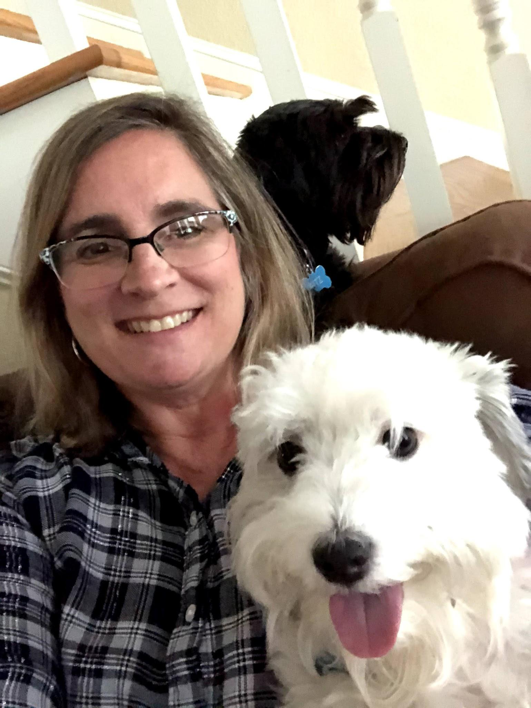
Kim
“....we do not take a trip; a trip takes us.”
― John Steinbeck, Travels with Charley: In Search of America
Our hope is
that NCTE takes you
to places
you’ve never dreamed of going~
that your experiences
here
ignite new passions
you never knew were there!

Slide 4
Cento (Kim)
Cento (taken from Latin for “patchwork”) poetry is composed entirely of existing lines of poetry, which appeals to reluctant writers while challenging them to think about each line they choose.
1)using large tongue depressors or tagboard, create a bank of lines one one side, title/author on the other;
2)invite writers to arrange the lines of their poems, photograph it when finished, and then photograph the flip side to credit the authors of each line as they appear in the poem;
3)use themes, forms, figurative language - the possibilities are endless!

Slide 5
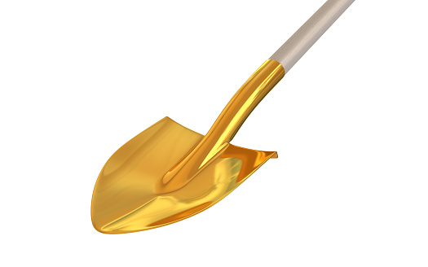
Other Ways to Use the Lines
*Students can use one line as the first to inspire the rest of an original poem;
*Students can use a line as a middle or last line of their own poem;
*Students can use each word in the line vertically as the beginning or ending word of each new line (Golden Shovel;
*Students can write a collaborative Cento poem!

Slide 6
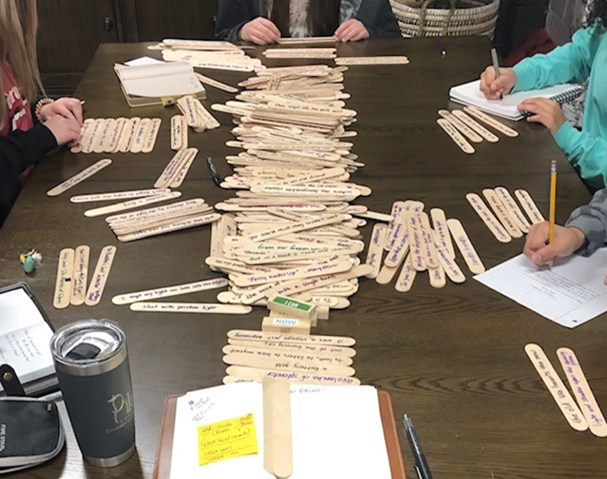
Writers in action
Upper elementary, middle, and high school students enjoy composing Cento poetry from a bank of lines of poetry.
Notes:
What a great photo! I love this!

Slide 7
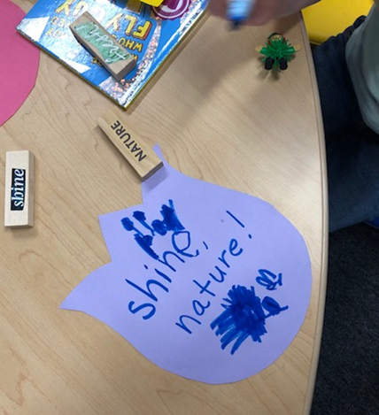
Pre-K students Bloom!
Pre-K and Primary school students enjoy composing their own poems using words on Jenga blocks.

Slide 8
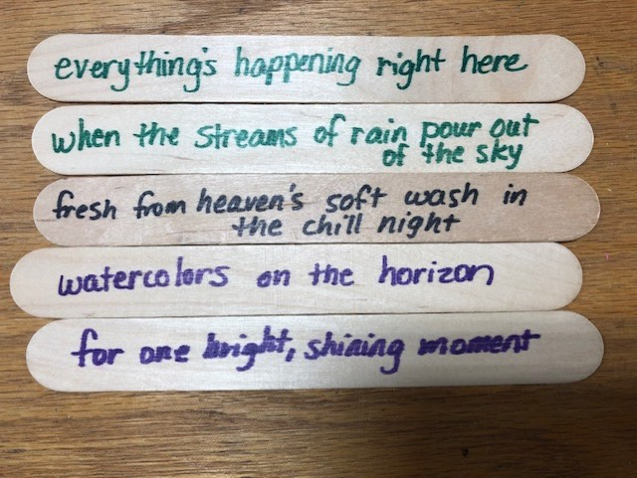
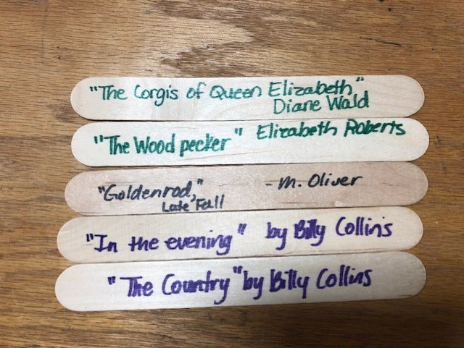
Cento Example in photos
Front Side Back Side
Notes:
Love these! This will be such fun!

Slide 9
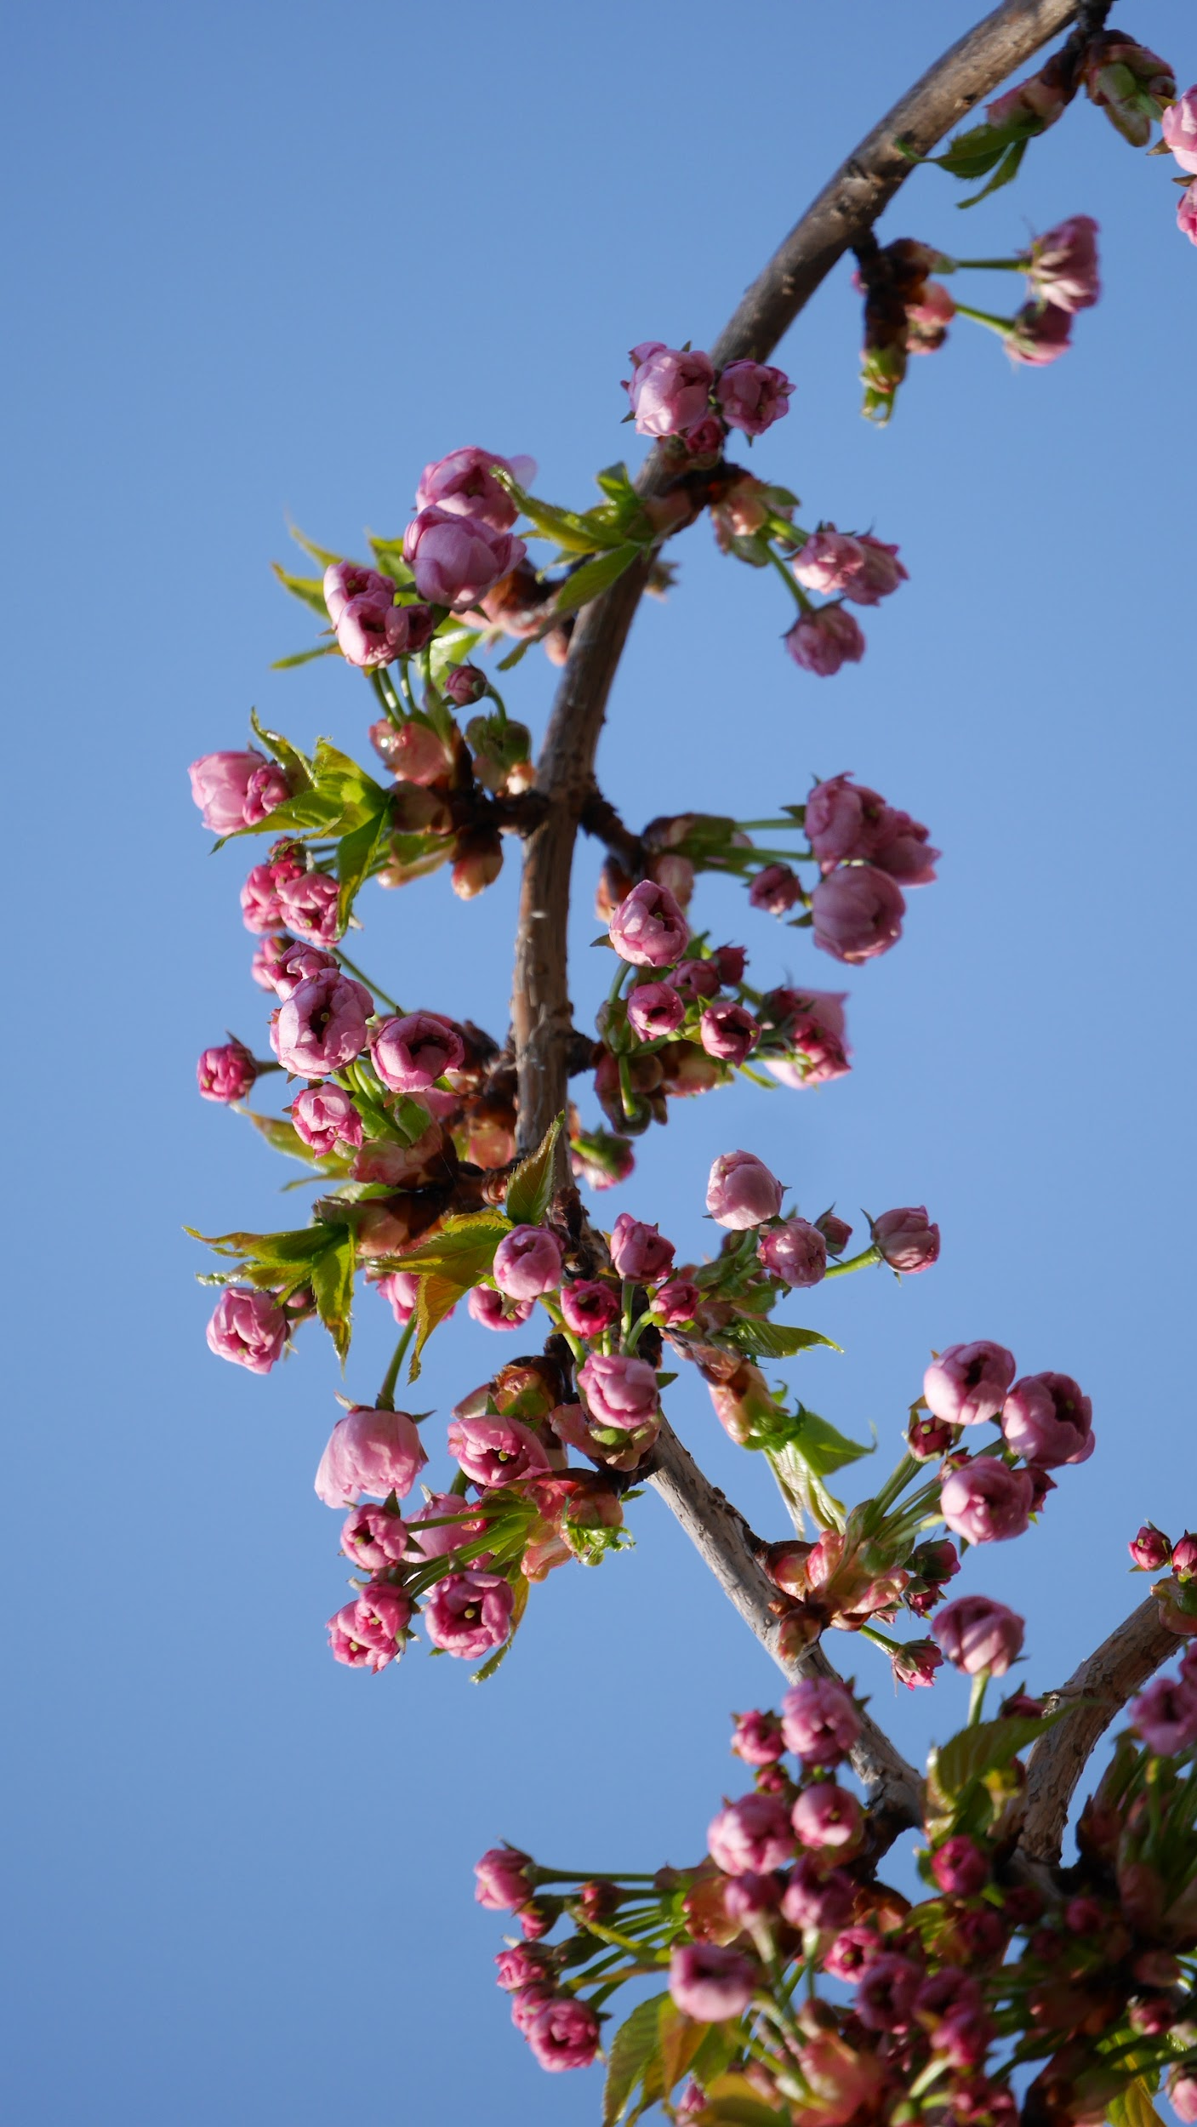
Responding (Allison)
Seeing students as buds:
What will unfurl their petals?
What will bring them into blossom?
Success.
Success.
Success.

Slide 10
Truth: you must write bad poems first (and forever)
Hey Kiddo example.
All poems have good moments.
Duolingo learning.

Slide 11
GivE kids an on-ramp
Model poems
YOUR poems
YOUR (modeled) need for response
YOUR (generous) observations
Classmates’ observations

Slide 12
CONSIDERATIONS:
Always “invite” sharing
Use back channels (email ahead of time: May I use your poem as a model?)
Offer to read aloud
Find GOLDEN LINES
Be ready with poetic EVIDENCE:
Alliteration
Enjambment
Anaphora
Imagery
Specifics

Slide 13
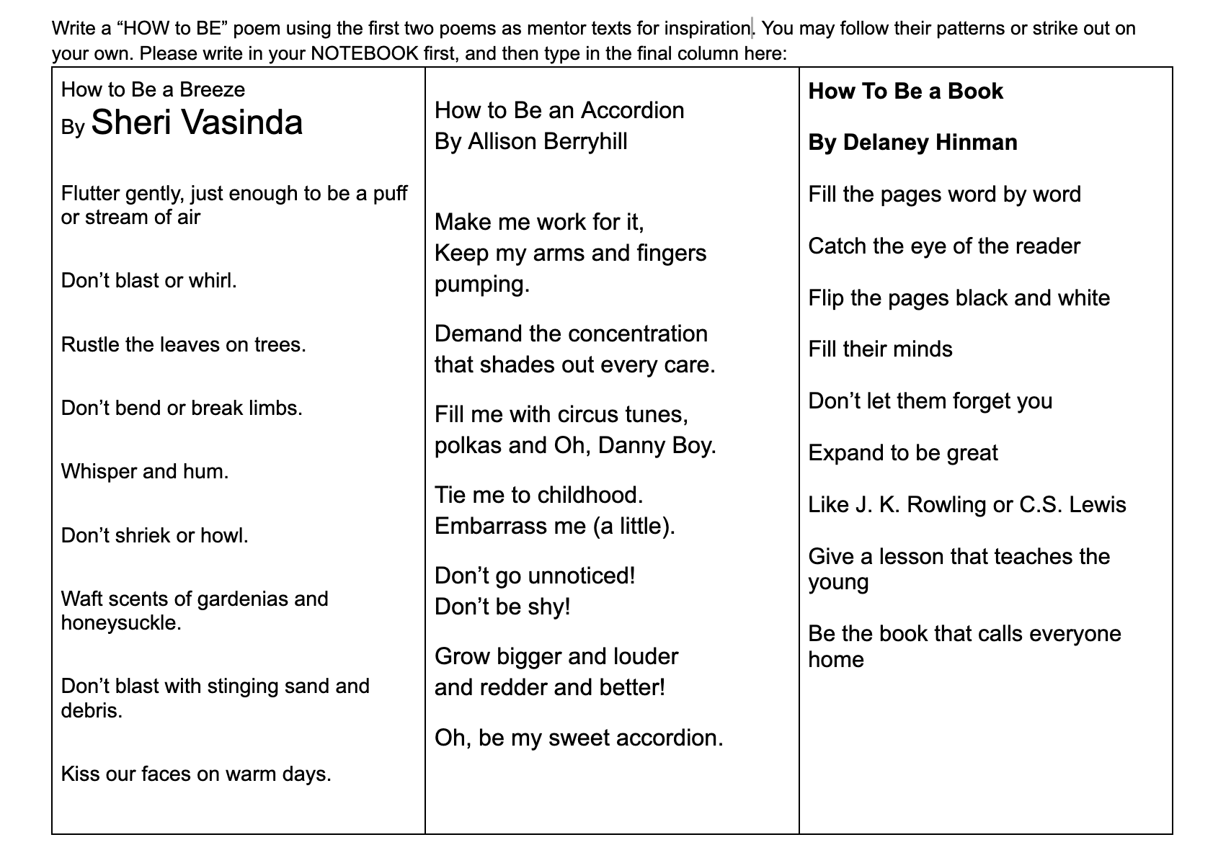

Slide 14
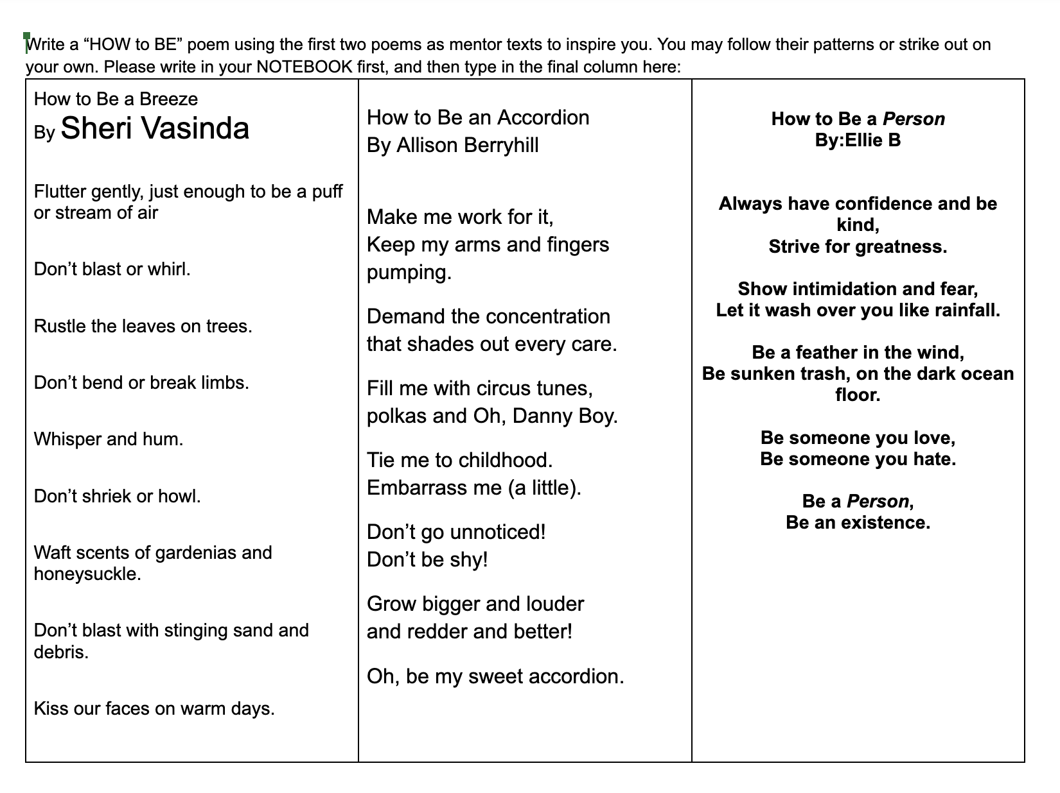
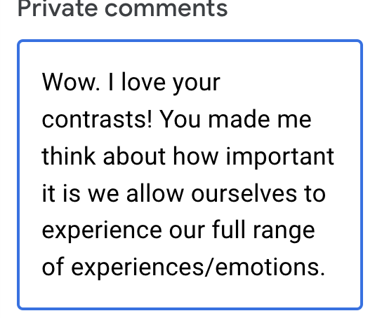

Slide 15
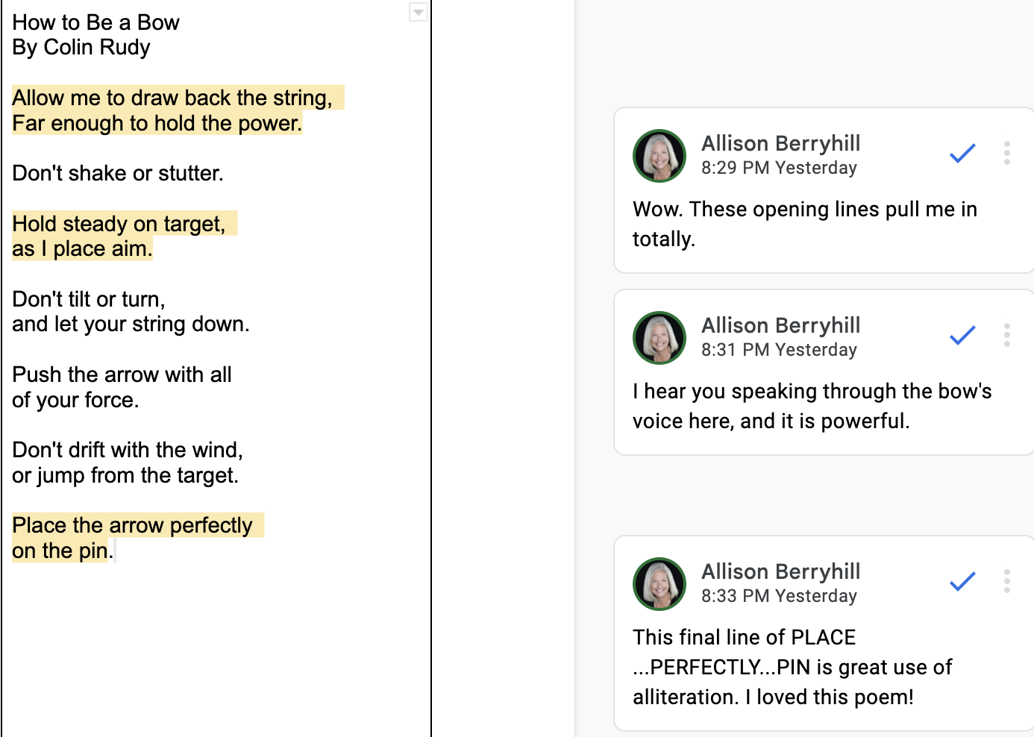

Slide 16
Blossoming
Share self-selected golden lines
Partner sharing:
Listen for a pleasing word combination
Name a poetic element
WIWI (wish I’d written it)

Slide 17
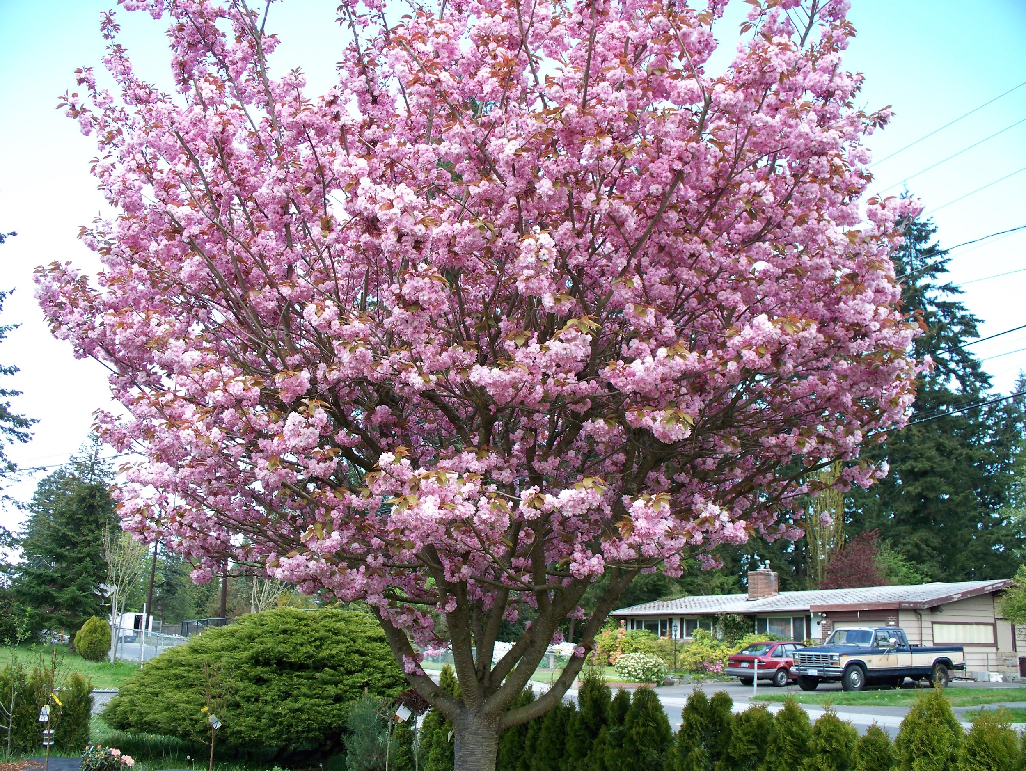
Too many poets are closed (doubtful) buds
Writing poetry is not about wide publication.
It is a way of experiencing life.
All students benefit from poetic invitation.
See each student as a bud.
Some are tightly closed.
Offer them sun.
Offer them water.
Watch them bloom.

Slide 18
Let’s Write!
Using Kim’s prompt, let’s write some poems!
Let’s respond to poems with Allison’s strategies.
Pleasing line or phrase
Poetic element
Golden line
WIWI

Slide 19
Contact Information for Allison and Kim
Allison Berryhill - 308berryhill@gmail.com
30 days of poetry invitations
Schoolblazing (Blog)
@allisonberryhil (Twitter)
Kim Johnson - kimjohnson66@gmail.com
Kimhaynesjohnson.com (Common Threads Blog)
@kimjohnson66 (Twitter)

