Slide 1
An Inclusive Literature Workshop: The Books and Conversations that Illuminate our Lives Within and Beyond the Classroom
Sarah J. Donovan, PhD Winston Campus Junior High DePaul University
ILC, PCC408 ~ October 1, 2016 ~ 9:30-10:30

Slide 2
Are the books in your “curriculum” inclusive*?
gender
sexuality
ability
race
culture
religion
geography
language
class
*inclusivity lists will always be partial
Which of these descriptor are most unfamiliar to your students?
Which books do your students love that stretched them into new ways of being in our world?

Slide 3
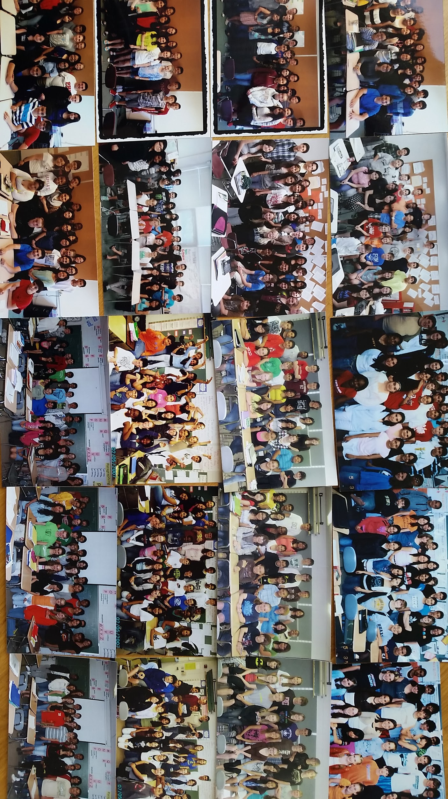
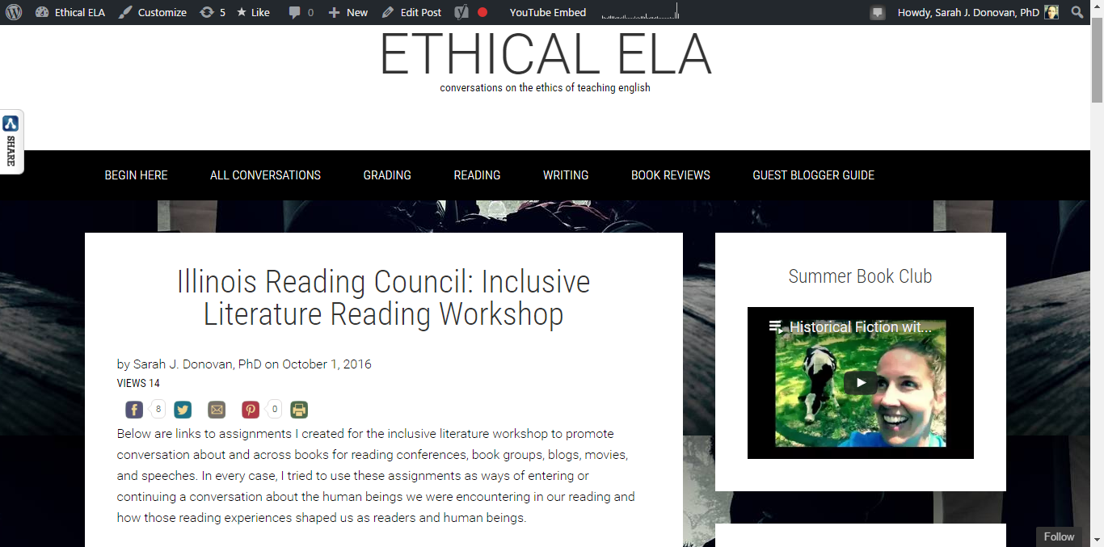
If we teach so that our students will sustain and improve our world, then they must imagine how our world ought to be.
And if that world is to be healthy, then our students must become conscious and seek out understanding of all that is humanity.
Books.
Sarah J. Donovan, PhD Winston Campus Junior High, Palatine DePaul University
ethicalela.com

Slide 4
A year long study:
What are our students’ reading experiences?
How can (will) books illuminate humanity and initiate conversations about how our world ought to be for 7th graders?
2015, pre-reading class survey

Slide 5
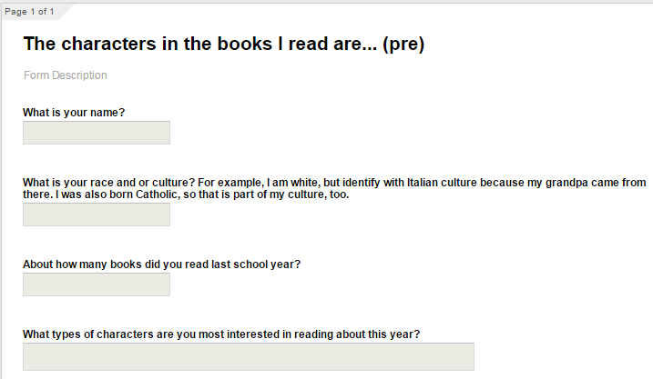

Slide 6
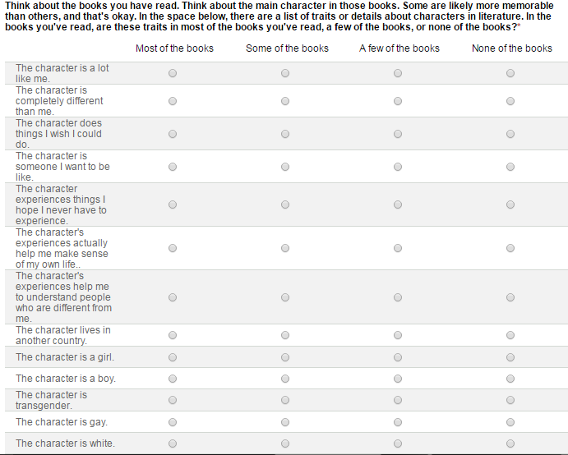

Slide 7
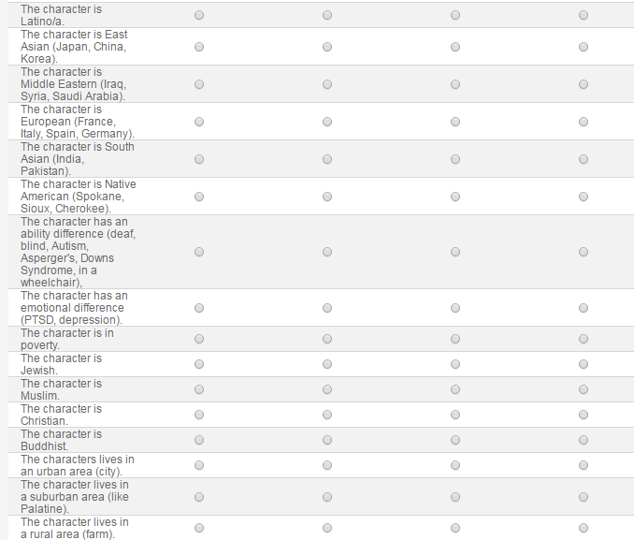

Slide 8
Pre-Reading Class Survey Results
September

Slide 9
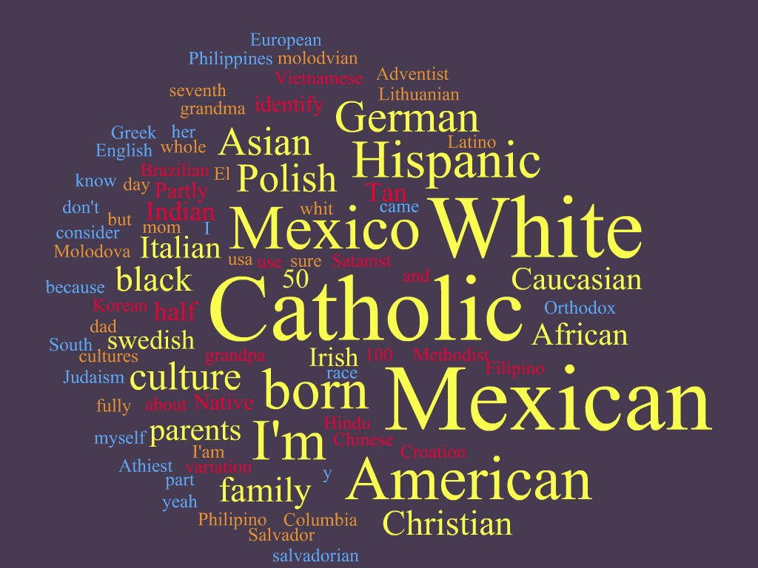

Slide 10
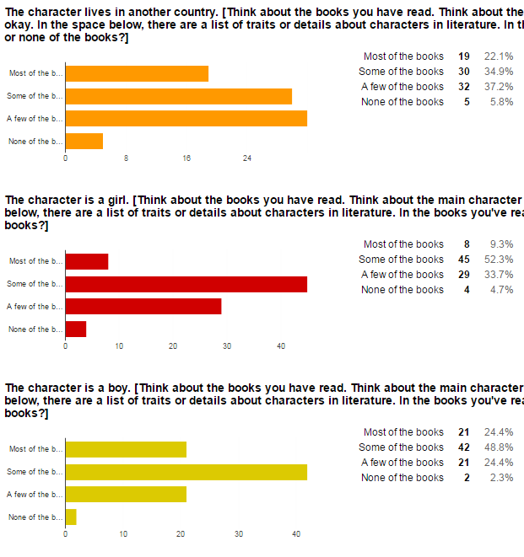
place
gender

Slide 11
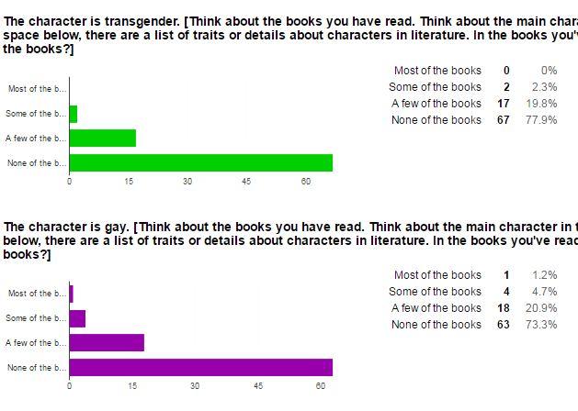
transgender
gay

Slide 12
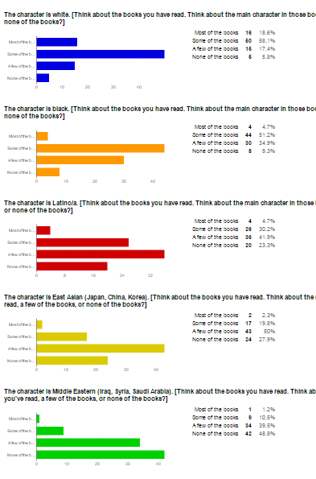
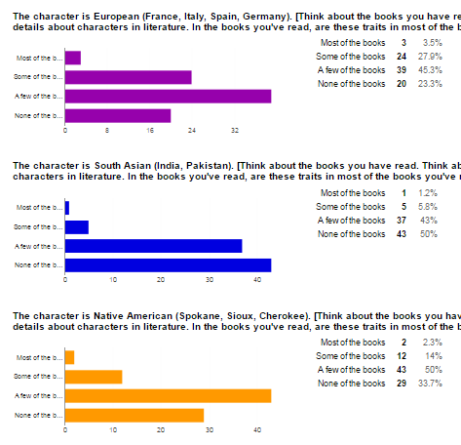
White
Black
Latino
East Asian
Middle Eastern
European
SouthAsian
Native American

Slide 13
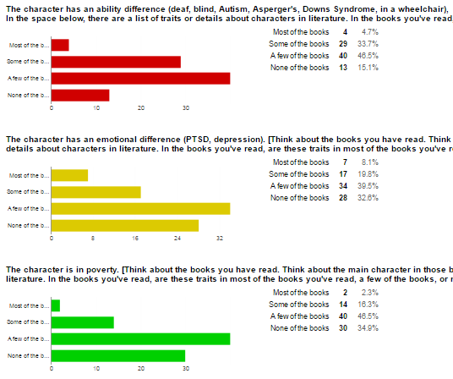
ability difference
emotional difference
poverty

Slide 14
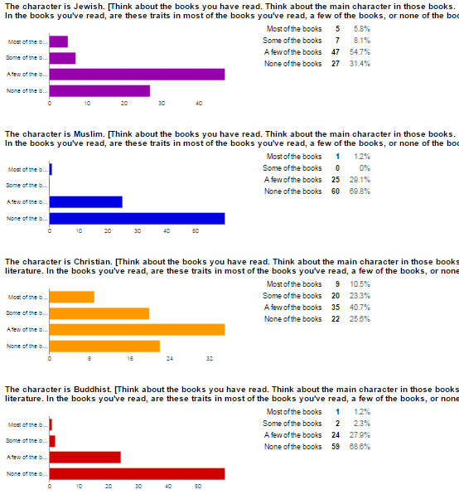
Jewish
Muslim
Christian
Buddhist

Slide 15
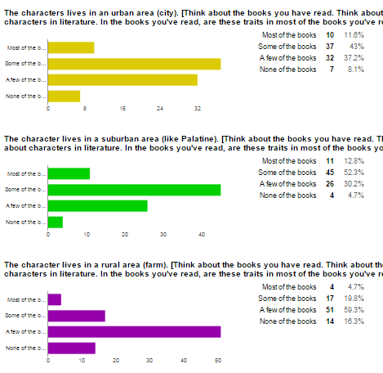
urban
suburban
rural

Slide 16
What did I learn?
What I didn’t learn...
some students had read quite widely.
half of my students had little or no experience reading books that featured or explored culture, religion, gender, sexual identity, ability difference, or class.
How did they read and think about these subjects?
In what ways could I support their reading -- critical lens, analysis, other points of view?
What impact might that have on their reading lives?

Slide 17
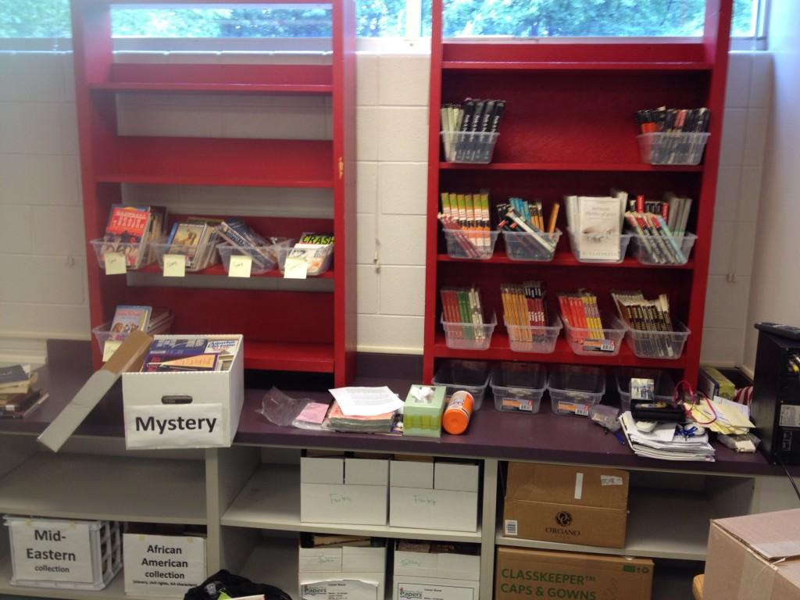
How can I promote more inclusive reading experiences?
Inventory current selections; fill in the gaps (lots)
Change the way I share book by making all books available at all times (for when they were ready/interested)
Learn how libraries work (categories, protecting books)
Read recommended books from Nerdy Book Club, We Need Diverse Books, Epic Reads, Brightly, Disability in Kidlit

Slide 18
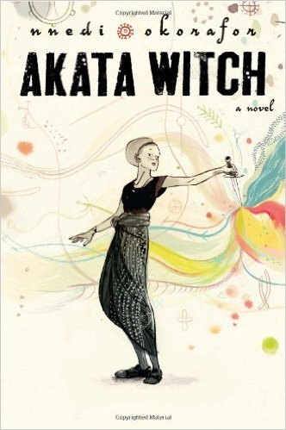
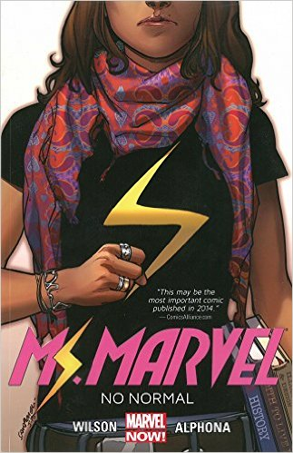
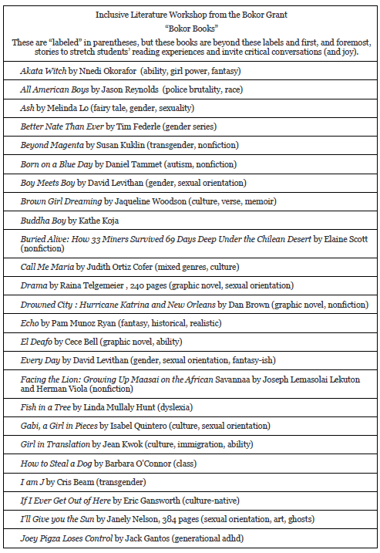
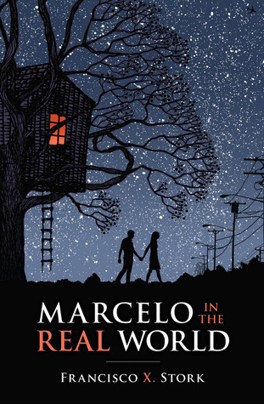
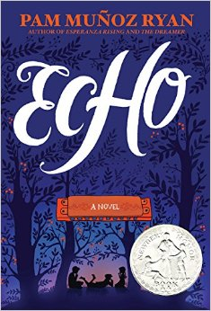
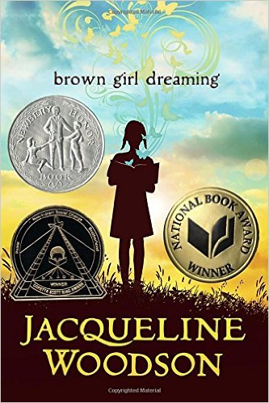
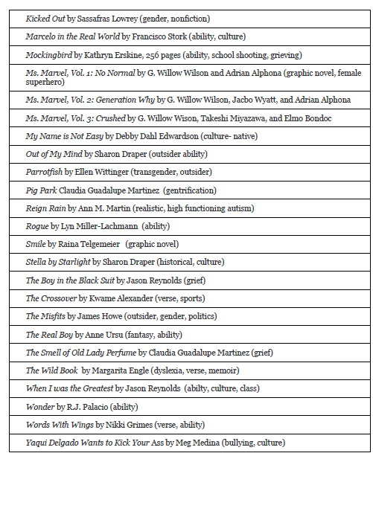
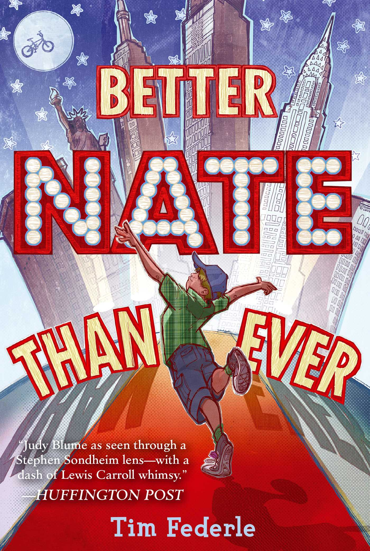
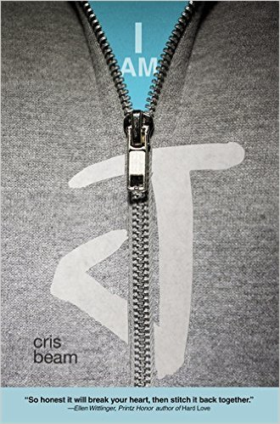
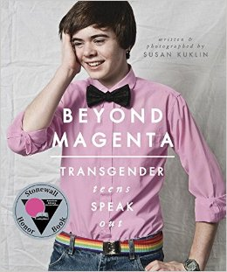
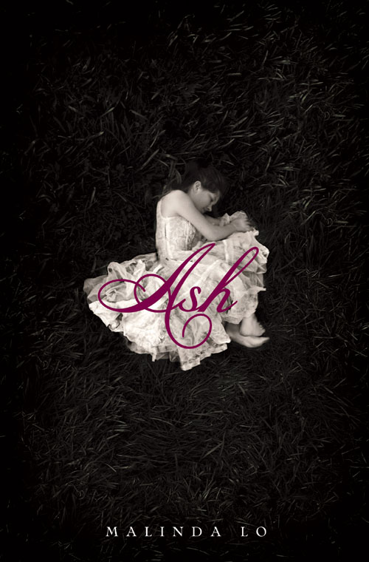
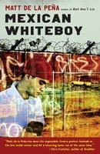
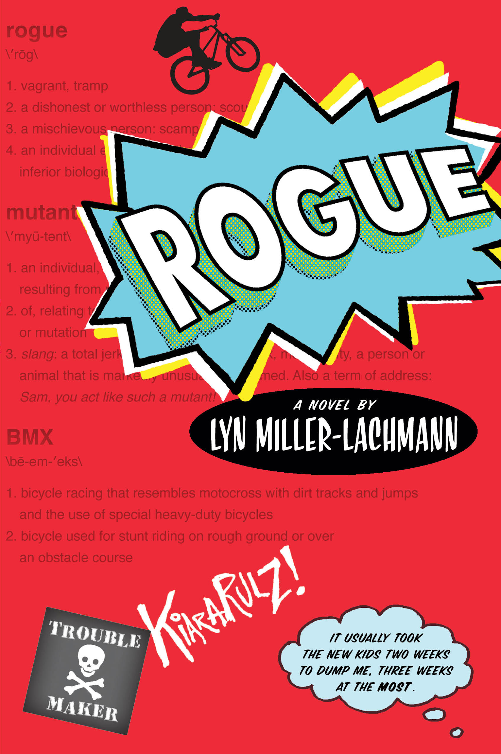
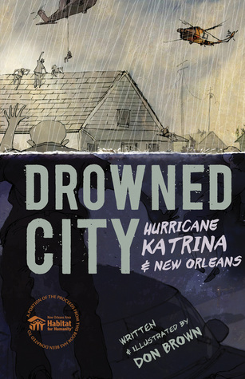
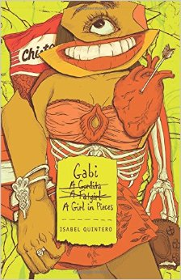
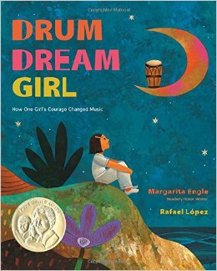
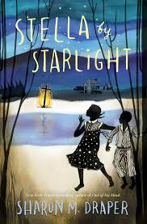
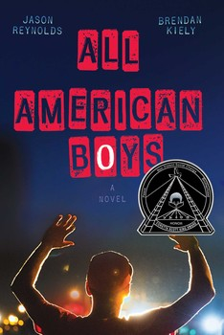
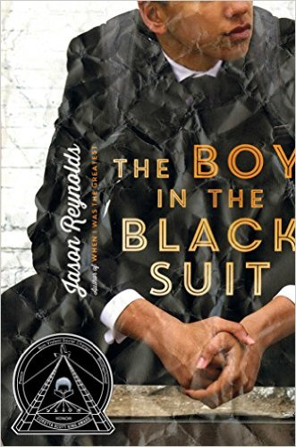
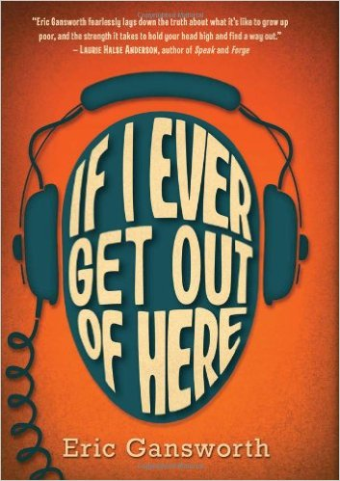
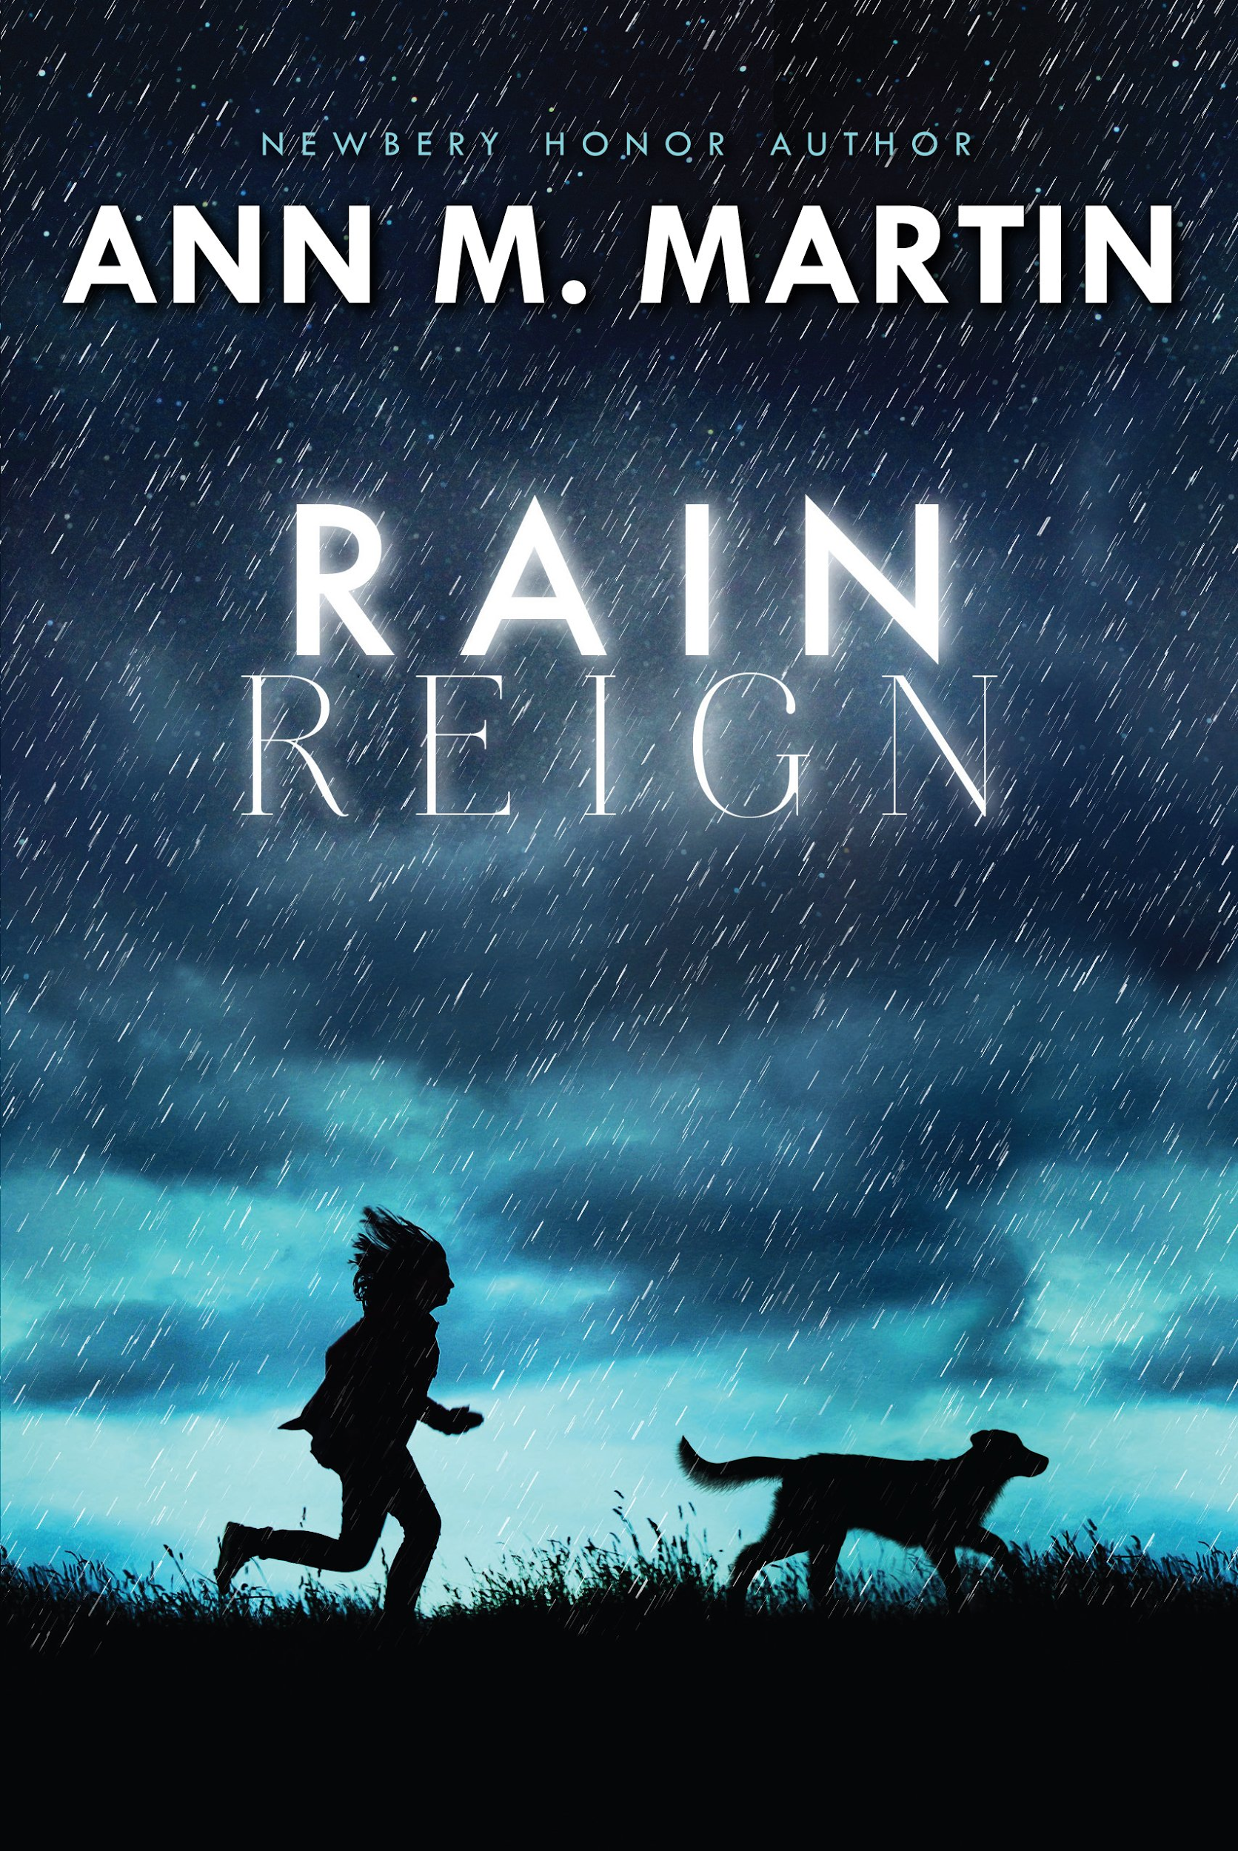

Slide 19
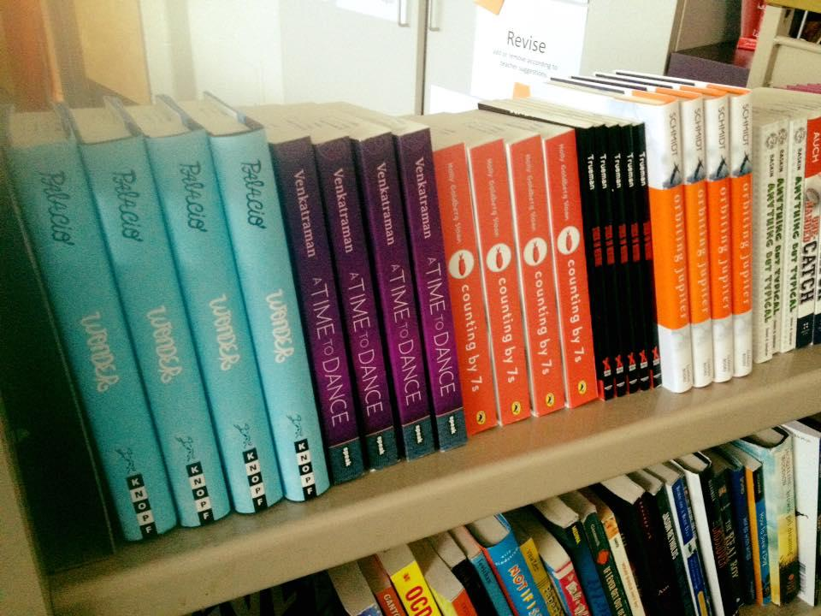
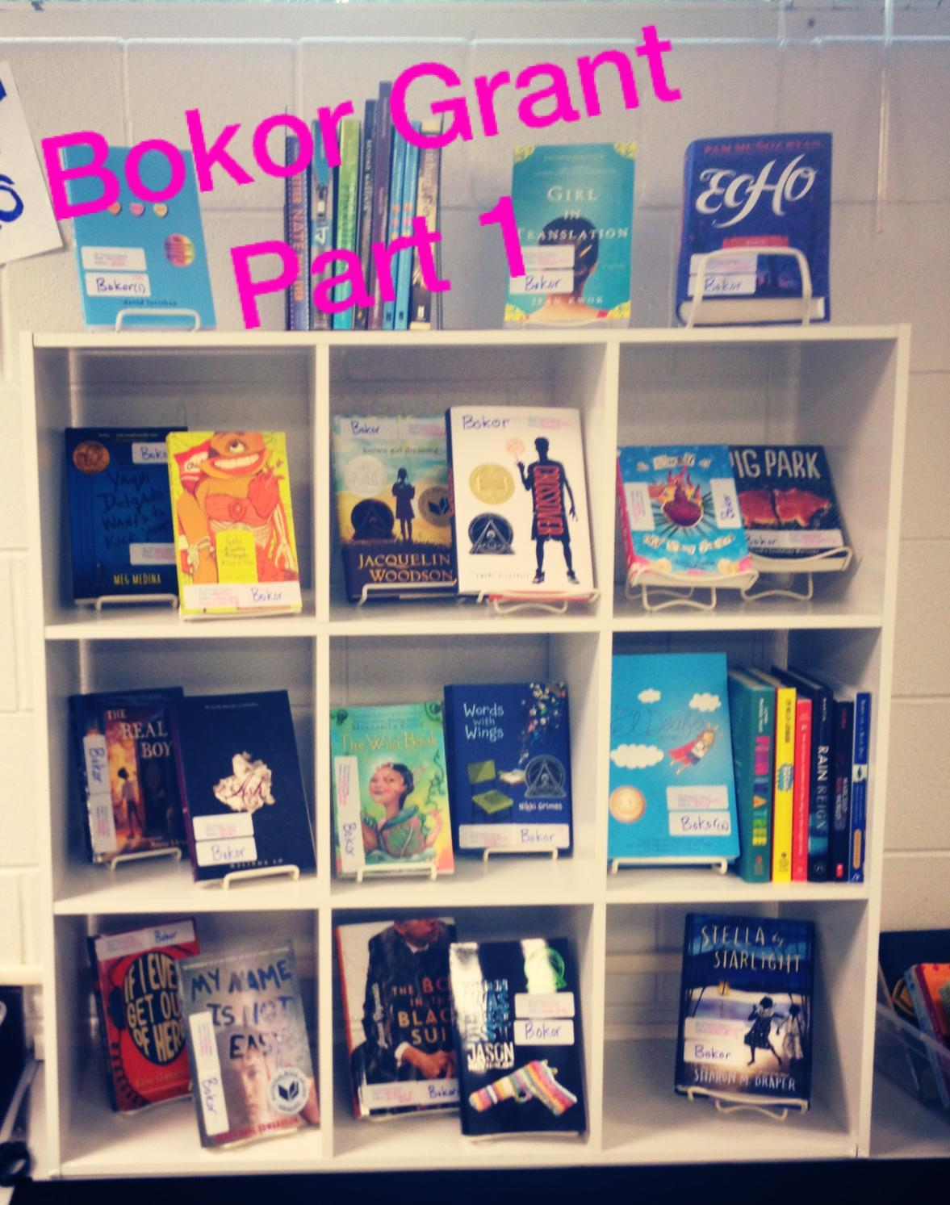
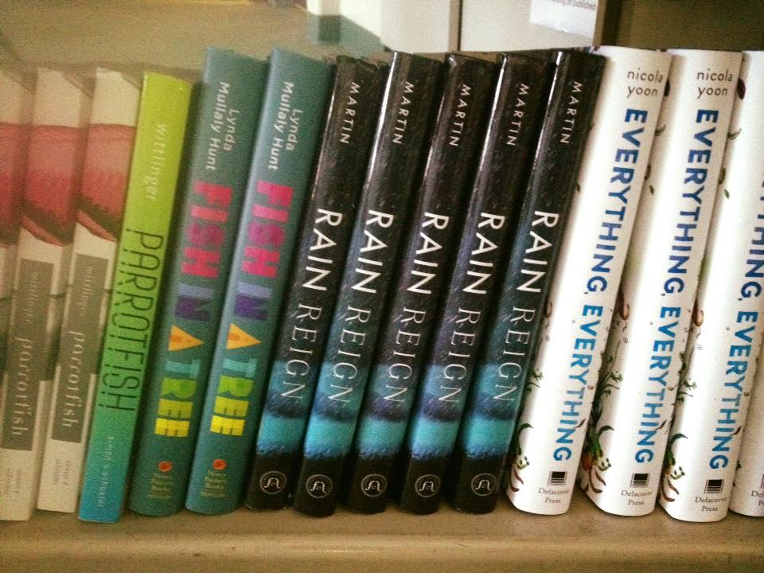
How can I afford a classroom library?
Grants
Students gift a book to the classroom
Book deals online
Crowd funding

Slide 20
How do I find time for
all of humanity in 41 minutes?
15 minutes: Daily independent reading with teacher conferences (exit slips,weekly blogs, quarterly reflections)
25 minutes *:
shared reading (Tree Girl, The Outsiders, poetry, speeches, spoken word)
book talks from the booklist (the lives not the category)
student-led poetry lessons, two-voiced spoken word on social issues, activist speeches inspired by wishes for change in the world
*Nancie Atwell,Donalyn Miller, Penny Kittle, Kelly Gallagher, Leslie Roessing, Jennifer Berne

Slide 21
Book groups
iMovies
Blogs with
virtual conference
Daily reading conferences
Activist Speeches
How can the assessment experience be more inclusive?
Change the way we read to be human-centered
Ask representation questions: How are you stretching? Whose voices are in-excluded? Who is the author? How does he/she represent difference?
Minimize points and grades to focus on discovery

Slide 22
book groups and iMovie

Slide 23
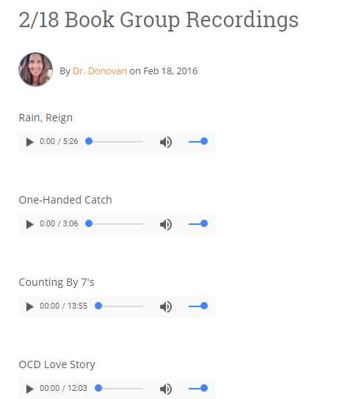
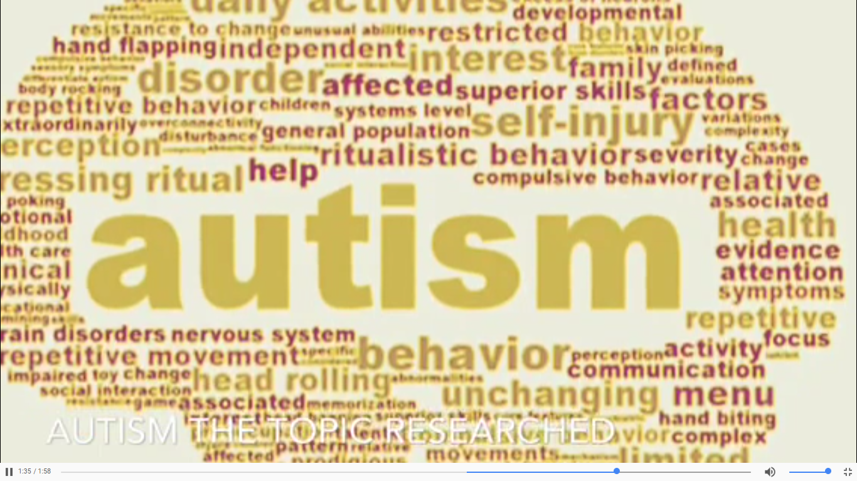
Anything But Typical by Nora Raleigh Baskin
Book Groups:
Discussion of “neurotypical” with (5:00, Autistic Spectrum Disorder, IEP)
iMovie: summary, window/mirror, research, critique of author’s representations and author’s preparation to write the book

Slide 24
weekly blogs with “virtual feedback”

Slide 25
one student’s choices

Slide 26
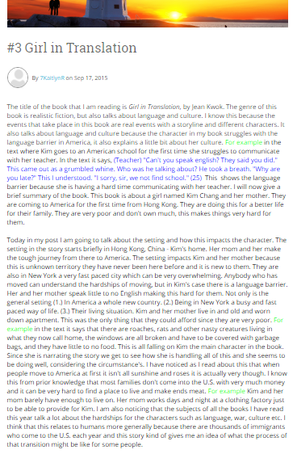
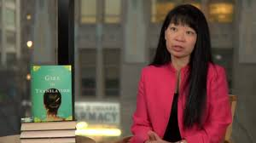
1) America is a new country. 2) Being in New York is a busy and fast-paced way of life. 3) Their living situation -- Kim and her mother live in an old, worn-down apartment...there are thousands of immigrants who come to the U.S. each year and this story gives me an idea of what the process of transition must be like for some people....
Girl in Translation by Jean Kwok

Slide 27
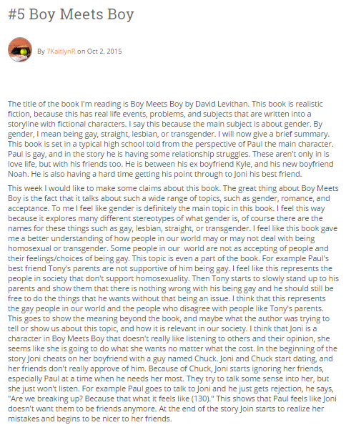
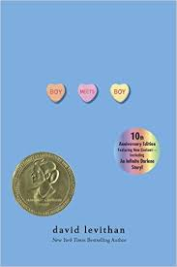
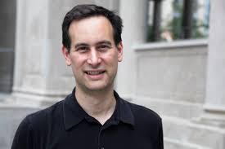
The great thing about Boy Meets Boy is the fact that it talks about such a wide range of topics, such as gender, romance, and acceptance...I feel like this book gave me a better understanding of how people in our world may or may not deal with being homosexual. Some people in our world are not as accepting of people. Tony starts to slowly stand up to his parents and tells them there is nothing wrong with is being gay. He is their son.
Boy Meets Boy by David Levithan

Slide 28
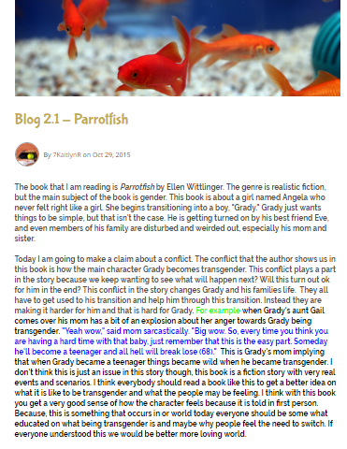
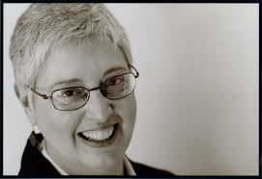
...everyone should be somewhat educated on what being transgender is and maybe why people feel the need to switch. If everyone understood this, we would be a better, more loving world.
Parrotfish by Ellen Wittlinger

Slide 29
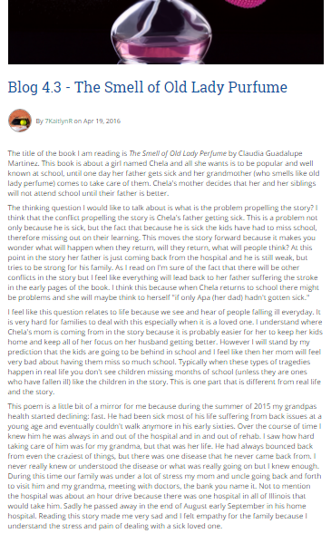
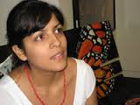
This is a mirror for me because during the summer of 2015 my grandpa’s health started declining: fast...I saw how hard taking care of him was for my grandma...during this time, our family was under a lot of stress...the hospital was an hour drive because there was one hospital in all of Illinois that would take him. Sadly, he passed away....Reading this story made me feel very sad and I felt empathy for the family...
The Smell of Old Lady Perfume by Claudia Guadalupe Mendez

Slide 30
more books, more lives

Slide 31
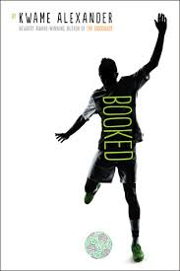
I aspire to a lot of goals just like Nick and Colby...I can relate to something on almost every page.
Booked by Kwame Alexander

Slide 32
El Deafo by Cece Bell

Slide 33
Anything But Typical by Nora Raleigh Baskin

Slide 34
When I Was the Greatest by Jason Reynolds

Slide 35
Never Fall Down by Patricia McCormick with Arn Chorn Pond

Slide 36
Words with Wings by Nikki Grimes

Slide 37
activism

Slide 40
post-reading survey

Slide 44
I learned that transgender and gay are two different things (Parrotfish and Boy Meets Boy).
War is not the same thing from the eyes of someone seeing it on the media as from someone seeing it happen right in front of them (Tree Girl).
I discovered it's heard to have a disease...you're treated differently (Everything, Everything).
That people argue a lot about these topics because I have read countless articles and stories about these issues and they argue a lot about how government should of done something, etc.
I learned that even with all these nasty things in the world, there is still happiness. Even though we can't see it, it's always there.
This year I learned about ways of life from books this year, I learned that women in Saudi Arabia had no rights to do much (but women can now drive). I learned that life can punch you in the gut because in books like Counting by Seven's Willow's life slowly ripped apart the was sown back together.
I have discovered that I have a lot of courage and I am willing to try something new. How did I figure out this through books? Well, the book "everything everything" showed me that its okay to step out of your comfort zone. It is one of the best books I have ever read.
I learned that even with all these nasty things in the world, there is still happiness. Even though we can't see it, it's always there.

Slide 45
I learned that culture does define who you are, it is apart of you. Yes, some people go to a different culture and learn new things, but its up to you to stay true to your self (The Absolutely True Diary of a Part-Time Indian).
Orbiting Jupiter because that book is a window to me because I can see the struggle that is happening between a teenage dad and his daughter.
I already knew that life and the real world is messed up, I already knew that lots of different people have very different lives, and I already knew that people of certain genders (like women, or people who are transgender) can have a really bad time in life. But, I did not know the struggles of someone who is mixed race. Which is strange, because I'm half Brazilian and half American. I've never looked into the subject of mixed race people, and how we could not know who we are, or where we belong. The book I read, called Nothing But The Truth (and a few white lies), helped me know more about this subject as a whole.
A social issue that I learned about would be women's rights in India. I learned that in Uttar Pradesh there is a gang of women who embarrass or beat up men who mistreat women called the Gulabi Gang.
I did not know the struggles of someone who is mixed race. Which is strange, because I'm half Brazilian and half American. I've never looked into the subject of mixed race people, and how we could not know who we are, or where we belong. The book I read, called Nothing But The Truth (and a few white lies), helped me know more about this subject as a whole.

Slide 46
Inclusive classroom libraries help us imagine the changes our world needs beyond our own lived experiences.
Books can help us imagine how to go about making those changes
together.

